Slide 1
Open Source Intelligence (passive Recon) Company: Valero
Ryan Coon
CYB-610
Professor Ian Standefer
March 26, 2025

Slide 2
Objectives
Research a fortune 500 company and one of its C-Suite officers to extract as much passive data.
Present findings of your attack
Present Spear Phishing email
Legal authorities and ethical considerations from a Christian Perspective

Slide 3

Installation

Slide 4
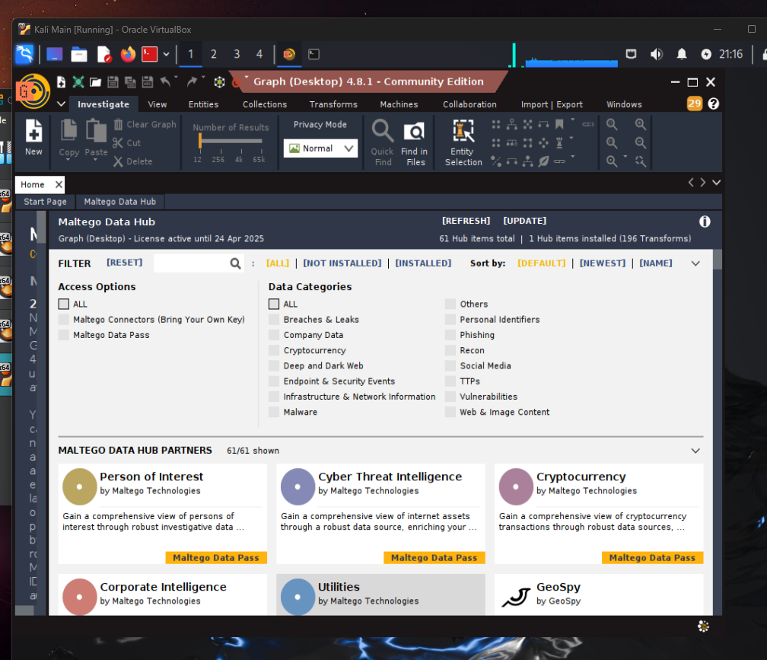
Sign up and use free
Version

Slide 5
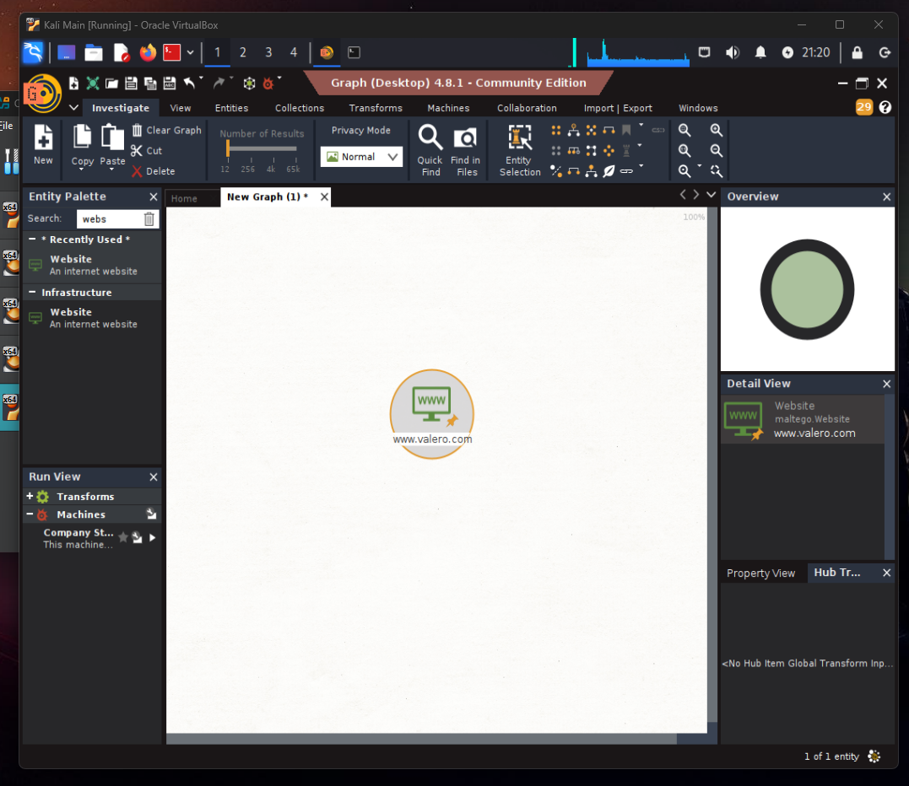
Click “new” and a
New graph will pop
up. From left menu under Infrastructure
Click and drag website to the graph.

Slide 6
Click “new” and a
New graph will pop
up. From left menu under Infrastructure
Click and drag website to the graph.

Slide 7
Click “new” and a
New graph will pop
up. From left menu under Infrastructure
Click and drag website to the graph.

Slide 8
PRODUCT OVERVIEW
UNIQUE
Only product specifically dedicated to this niche market
FIRST TO MARKET
First beautifully designed product that's both stylish and functional
TESTED
Conducted testing with college students in the area
AUTHENTIC
Designed with the help and input of experts in the field

Slide 9
PROBLEM
MARKET GAP
Few, if any, products on the market help customers like we do
CUSTOMERS
66% of US consumers spend money on multiple products that only partially resolves their issue
FINANCIALS
Millennials account for about a quarter of the $48 billion spent on other products in 2018
COSTS
Loss of productivity costing consumers thousands of dollars

Slide 10
PRODUCT BENEFITS
Cool and stylish product
Areas for community connections
Online store and market swap

Slide 11
COMPANY OVERVIEW

Slide 12
BUSINESS MODEL
ABSTRACT
We based our research on market trends and social media
DESIGN
We believe people need more products specifically dedicated to this niche market
RESEARCH
Minimalist and easy to use

Slide 13
MARKET OVERVIEW
$3 Billion
$1 Billion
$2 Billion
Freedom to invent
Selectively inclusive market
Serviceable available market
Opportunity to build
Fully inclusive market
Total addressable market
Few competitors
Specifically targeted market
Serviceable obtainable market

Slide 14
Market comparison
$3B
$2B
$1B
Opportunity to build
Freedom to invent
Few competitors
Addressable market
Serviceable market
Obtainable market

Slide 15
OUR COMPETITION
CONTOSO
COMPETITORS
Our product is priced below that of other companies on the market
Design is simple and easy to use, compared to the complex designs of the competitors
Affordability is the main draw for our consumers to our product
Company A Product is more expensive
Companies B & C Product is expensive and inconvenient to use
Companies D & E Product is affordable, but inconvenient to use

Slide 16
Our competition
Convenient
Contoso
Competitor A
Affordable
Expensive
Competitor D
Competitor C
Competitor B
Competitor E
Inconvenient

Slide 17
Growth strategy
Feb 20XX
Roll out product to high profile or top-level participants to help establish the product
Mar 20XX
Release the product to the general public and monitor press release and social media accounts
Oct 20XX
Gather feedback and adjust product design as necessary

Slide 18
TRACTION
Forecasting for success
Key Metrics
 | Clients | Orders | Gross revenue | Net revenue
20XX | 10 | 1100 | $10,000 | $7,000
20XX | 20 | 200 | $20,000 | $16,000
20XX | 30 | 300 | $30,000 | $25,000
20XX | 40 | 400 | $40,000 | $30,000

Slide 19
TWO-YEAR ACTION PLAN
DRAFT BLUEPRINTS
GATHER FEEDBACK
DELIVER TO CLIENT
20XX
JAN
FEB
MAR
APR
MAY
JUN
JUL
AUG
SEP
OCT
NOV
DEC
20XX
JAN
FEB
MAR
APR
MAY
JUN
JUL
AUG
SEP
OCT
NOV
DEC
RUN FOCUS GROUPS
TEST DESIGN
LAUNCH DESIGN

Slide 20
FINANCIALS
 | Year 1 | Year 2 | Year 3
INCOME
Users | 50,000 | 400,000 | 1,600,000
Sales | 500,000 | 4,000,000 | 16,000,000
Average price per sale | 75 | 80 | 90
Revenue @ 15% | 5,625,000 | 48,000,000 | 216,000,000
GROSS PROFIT | 5,625,000 | 48,000,000 | 216,000,000
Expenses
Sales & marketing | 5,062,500 | 38,400,000 | 151,200,000 | 70%
Customer service | 1,687,500 | 9,600,000 | 21,600,000 | 10%
Product development | 562,500 | 2,400,000 | 10,800,000 | 5%
Research | 281,250 | 2,400,000 | 4,320,000 | 2%
TOTAL EXPENSES | 7,593,750 | 52,800,000 | 187,920,000

Slide 21
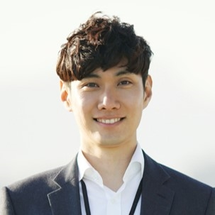



MEET THE TEAM
TAKUMA HAYASHI​
MIRJAM NILSSON​
FLORA BERGGREN​
RAJESH SANTOSHI​
President
Chief Executive Officer
Chief Operations Officer
VP Marketing

Slide 22
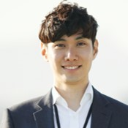

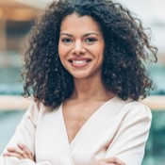

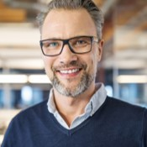
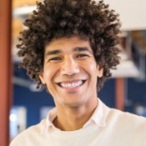


MEET THE TEAM
TAKUMA HAYASHI
MIRJAM NILSSON​
FLORA BERGGREN​
RAJESH SANTOSHI
President
Chief Executive Officer
Chief Operations Officer
VP Marketing
GRAHAM BARNES
ROWAN MURPHY
ELIZABETH MOORE
ROBIN KLINE
VP Product
SEO Strategist
Product Designer
Content Developer

Slide 23
SUMMARY
At Contoso, we believe in giving 110%. By using our next-generation data architecture, we help organizations virtually manage agile workflows. We thrive because of our market knowledge and great team behind our product. As our CEO says, "Efficiencies will come from proactively transforming how we do business.”

Slide 24
THANK YOU
Mirjam Nilsson​
206-555-0146
mirjam@contoso.com
www.contoso.com

